Slide 1
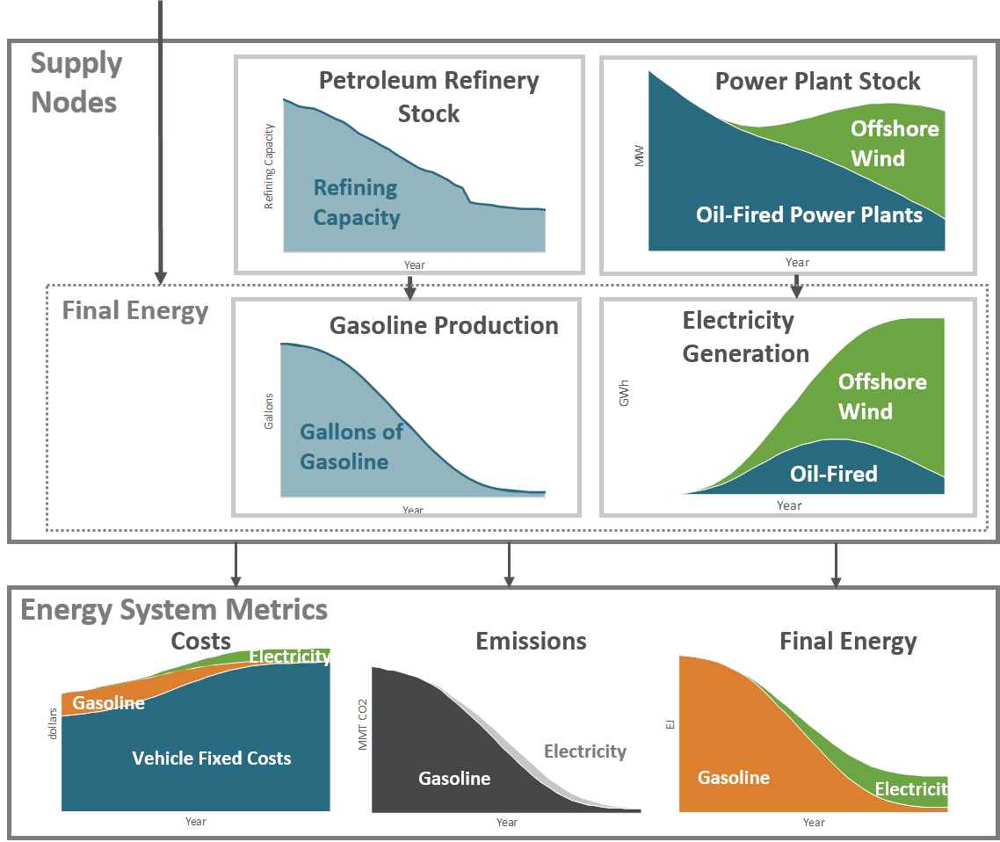
Demand Drivers
New Vehicle Sales
Energy Service Demand
by Vehicle Type
Population
VMT per Capita
EV
EV
ICE
PHEV
ICE
PHEV
Energy Service Demand
Vehicle Stock
Vehicle Miles Traveled
EV
ICE
PHEV

Slide 2
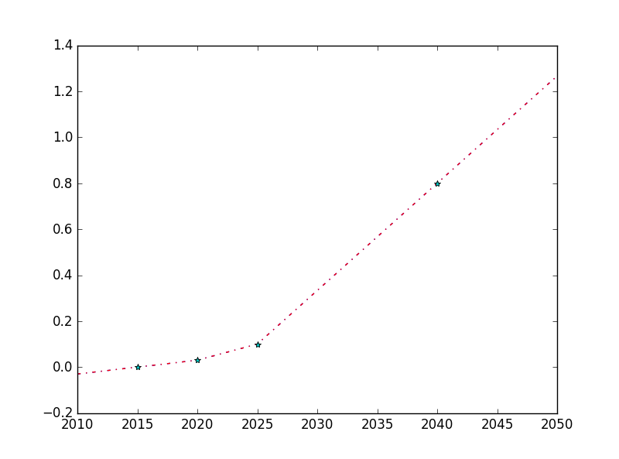
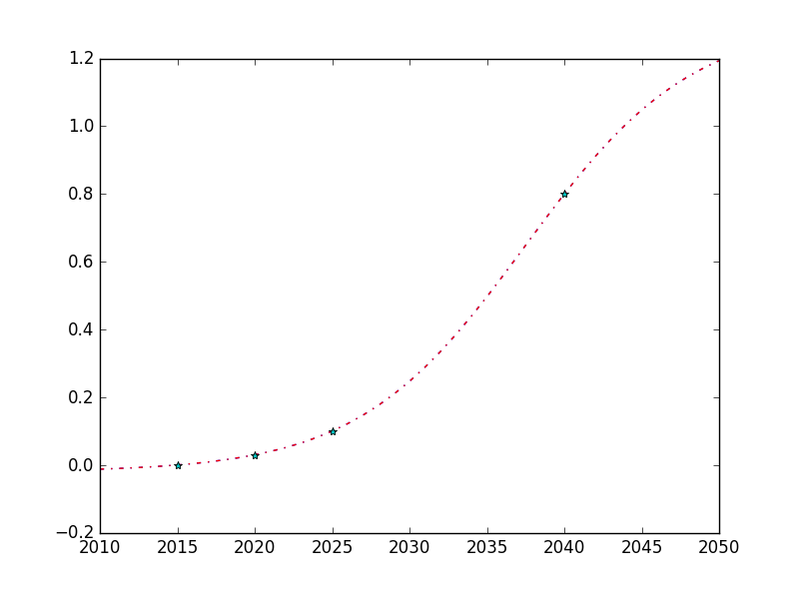
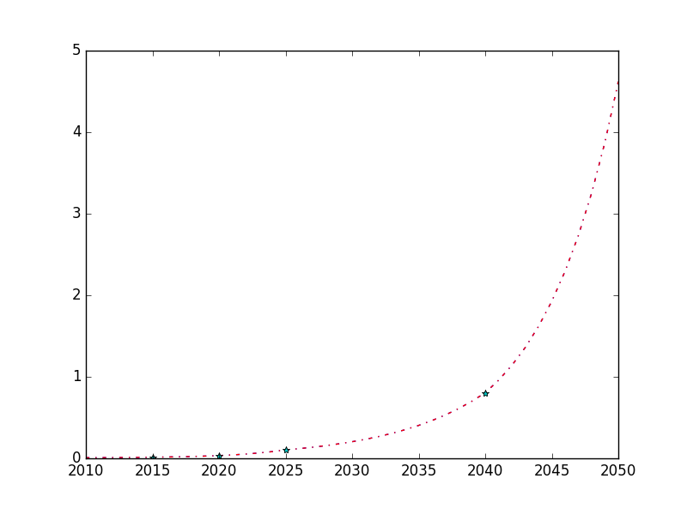
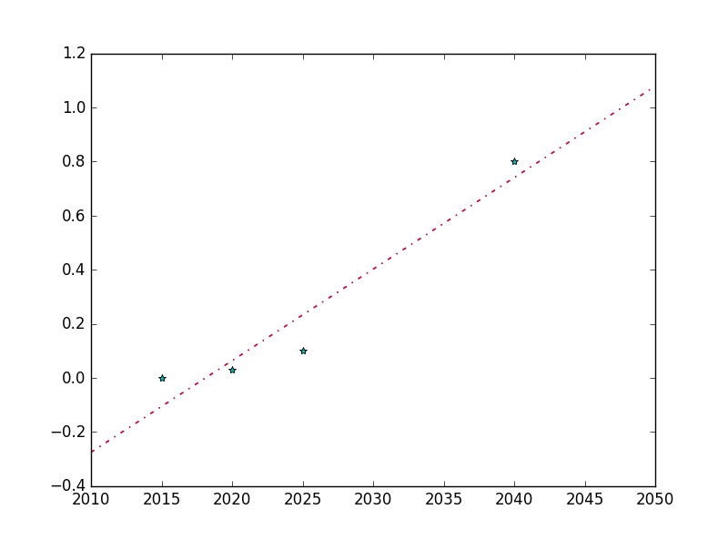
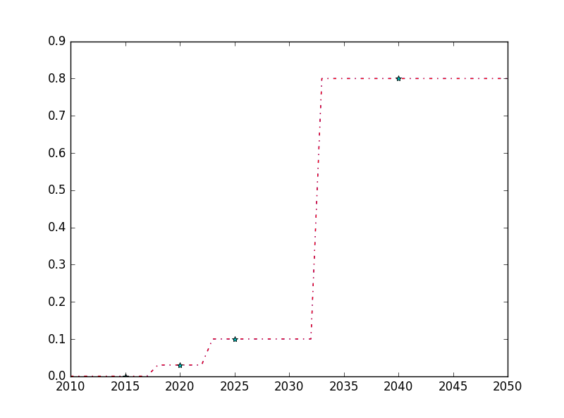
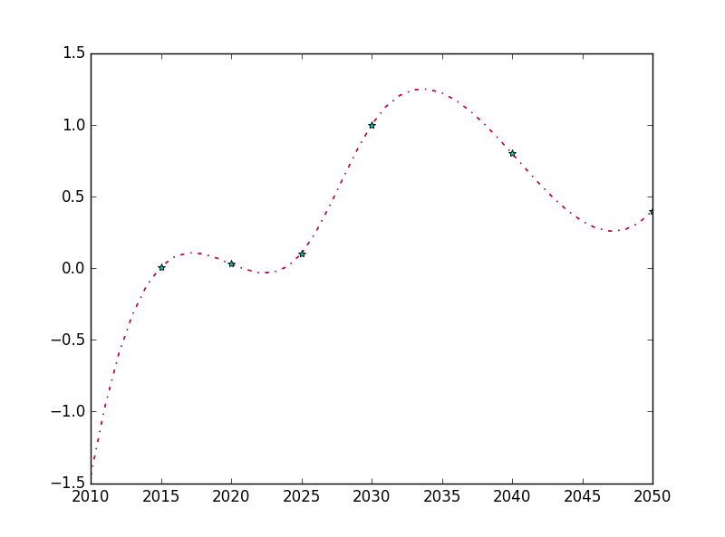
linear_interpolation
logistic
exponential_regression
linear_regression
nearest
cubic

